Slide 1
User-Customized Restaurant Recommendation using NLP on Yelp Dataset
Spring 2020: CSE6240: Web search and Data Mining
Somdut Roy
Vitaly Marin
Devanshee Shah
slide version 4.3

Slide 2
Motivation/Introduction
Problem Description:
In this project, we intend to provide a user, who mentions his/her favorite restaurant name/type, with a list of relevant restaurants in the city along with a possible rating he/she is likely to give those restaurants.
This breaks our problem into two distinct parts
A rating predicting system (to predict ratings for suggested restaurants)
A recommender system (to suggest those restaurants to a user)
Problem Importance:
This provides a user, a list of restaurants only based on the information about favorite restaurant.
Along with that, our model is capable of predicting the stars that the user is going to give each of those recommended restaurants. Here lies the uniqueness in our problem,

Slide 3

Methodology: Text Encoding
Our baseline is based on a paper by Kulkarni et al., where they use review text to predict the ratings.
While we use their machine learning techniques to create our baselines, the paper does not specify the method for word embedding. This gives us liberty to explore options for word embedding techniques.
In assignment 2 of this course, we learned to use word2vec. So that was an option. However, going by a blog by Anon (2016), using fastText suits best for a moderately small dataset like ours.
We create embedding for reviews using the method shown here →
Review Sentence
Remove Stopwords
Remove html tags
Remove special characters
Filtered Review Words
(trained using review dictionary of our data)
Set of vector representations of review words
Averaging vectors
Review Vector

Slide 4
Methodology: Baseline Approaches/Algorithms
What are our baseline Approaches ?
Baseline Approach #1: Linear SVM classifier (Kulkarni et al)
Baseline Approach #2: Logistic Regression
Description of how each baseline
approach work (baseline 1) : as shown here →
Description of how each baseline
approach work (baseline 2): as shown here →
Yelp Restaurant Review- Rating Dataset
Ratings + Reviews
User Reviews
Restaurant Reviews
Training for Ratings using
Baseline 1: Linear SVM
Baseline 2: Logistic Regression

Slide 5
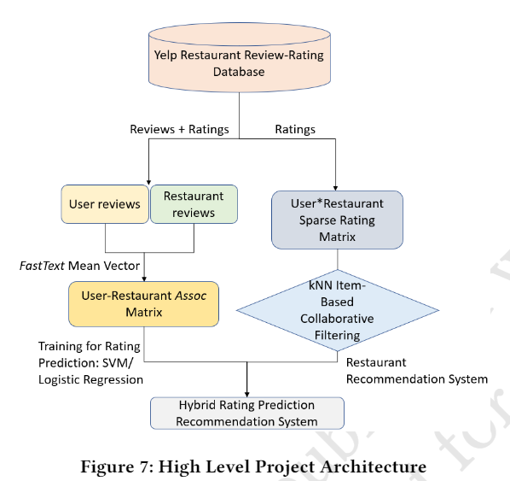
Our Approach/Algorithms Description
Our approach combines user restaurant ratings prediction based on Linear SVM (Baseline 1), Logistic Regression (Baseline 2) and item based collaborative filtering techniques to create a hybrid ratings that can be used to sort the relevant restaurants for a specific user that user given only user’s preference for specific restaurant.
Our model is summarized in the diagram →

Slide 6
Our Approach and Benchmarks #1, 2 using accuracy metric
Yelp Restaurant Review- Rating Dataset
Yelp Restaurant Review- Rating Dataset
User Reviews
Restaurant Reviews
Set of Reviews
Corresponding
Star Rating
-->
User-Restaurant AssocMatrix
Training for Ratings using
Baseline 1: Linear SVM
Baseline 2: Logistic Regression
Training/Testing for Ratings using Method 1 : Linear SVM and
Method 2: Logistic Regression

Slide 7
User-Restaurant Assoc Matrix Creation I
Set of reviews
Ratings
→
Yelp Review-Rating Database
Aggregated reviews for each user
Aggregated reviews for each restaurant
Aggregated User Review Vector
Aggregated Restaurant Review Vector

Slide 8
User-Restaurant Assoc Matrix Creation II
Process of creating Assoc vector
Assoc matrix from Assoc vector
Example:
User-i: Restaurant-j: Star-ij
Appended User-1 Restaurant-1 Assoc Vector
: Star-11
Appended User-2 Restaurant-2 Assoc Vector
: Star-22
Aggregated User-i Review Vector
Aggregated Restaurant-j Review Vector
Appended User-i Restaurant-j Assoc Vector
: Star-ij
Appended User-i Restaurant-j Assoc Vector
Appended User-m Restaurant-n Assoc Vector
: Star-mn
Assoc Matrix

Slide 9
Our Approach Combined for a recommender tool with hybrid qualitative ratings (right)
Yelp Restaurant Review- Rating Dataset
Ratings + Reviews
User Reviews
Restaurant Reviews
User-Restaurant AssocMatrix
Training/Testing for Ratings using Method 1 : Linear SVM and
Method 2: Logistic Regression

Slide 10
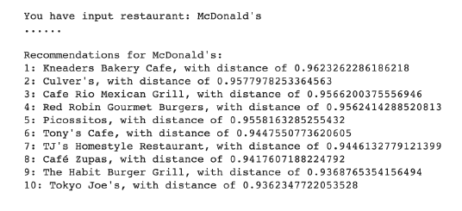
KNN –Item based Collaborative Filtering
Fuzzy method and Cosine similarity distances used to get 10 restaurant recommendations for given query word.
Result distances further computed with user-restaurant assoc matrix to get hybrid rating.
Users
 | 1 | 2 |  | n-2 | n-1 | n
1 | 0 | 3 |  | 4 | 4 | 3
2 | 1 | 2 |  | 4 | 3 | 2
m-2 | 2 | 4 |  | 3 | 2 | 0
m-1 | 2 | 4 |  | 3 | 2 | 0
m | 1 | 2 |  | 4 | 5 | 3
Restaurants
User- Restaurant Sparse Matrix for Collaborative Filtering
Restaurants m-2 and m-1 are having very high cosine similarity based on the ratings to both the restaurants given by users 1, 2, n-2 and n-1.

Slide 11
Our Approach/Algorithms Novelty
The Novelty of our approach is to create the hybrid ratings by combining rating prediction for restaurants and Item based collaborative filtering to restaurant dataset together.
Created the Associative Matrix and used the FastText.
(potentially combine this slide with other slides or so)

Slide 12
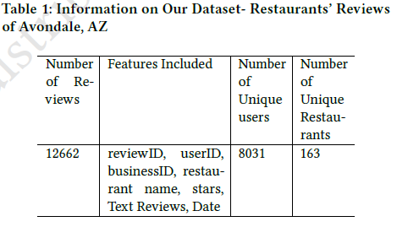
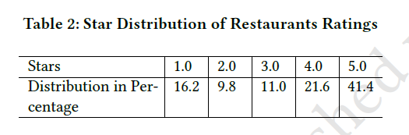
Our Dataset: Filtered Yelp Dataset. Finalized
Description of dataset and its useful features and our dataset was constructed using Yelp dataset using Avondale, AZ city.

Slide 13
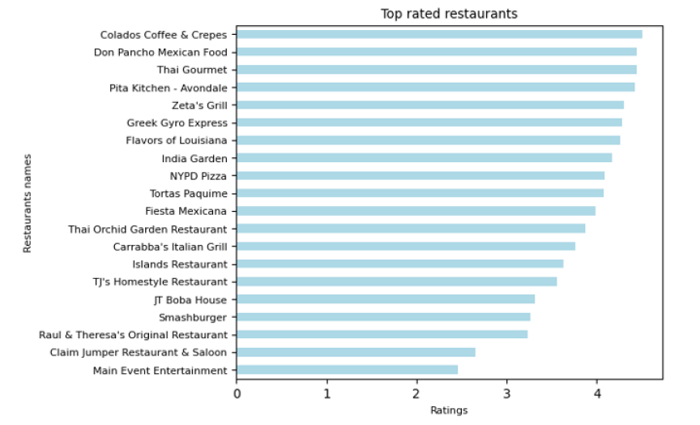
Our Dataset: customized Yelp Dataset. Finalized Cont. Features/Details

Slide 14
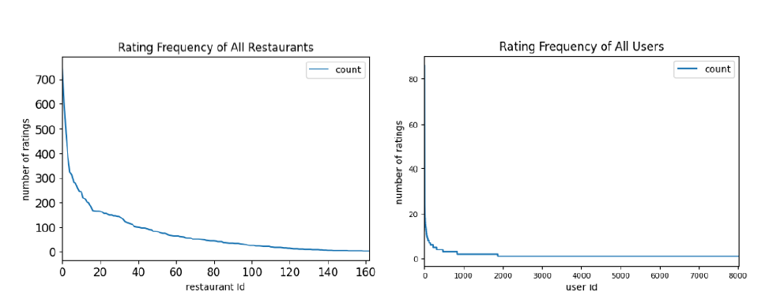
Our Dataset: Rating Frequency of Restaurants’ and User Frequency of all users

Slide 15
Experiments and Evaluations
Description of the experimentation setup .
We used Google Colab to run our experiments.
To ensure fair comparison between different processes, interferences from other processes was kept to a minimum.
Description of evaluation criteria for the experiment:
The success of our experiment was evaluated with the accuracy of predicted stars.

Slide 16
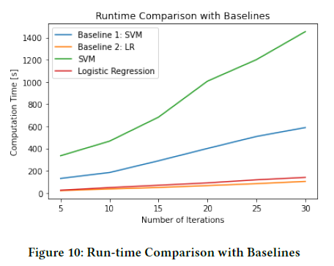
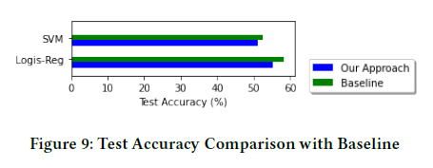
Our Results
<todo add info on results>.

Slide 17
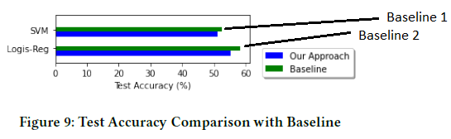
Our Results and Comparison to Baseline Results.
Using Accuracy as the measure of performance
and time in seconds as wall time for each algorithm
Our results are shown here.

Slide 18
Summary of Our results
Method | Accuracy | Time Compcomplexity
Baseline 1 SVM without Matrix (what paper ?) |  | Somdut will provide the numbers on this
Our Approach with Matrix SVM |  | Somdut will provide the numbers on this
Our Approach Logistic Regression with Matrix |  | Somdut will provide the numbers on this
Our Approach Logistic Regression without Matrix |  | Somdut will provide the numbers on this
Baseline 2 Logistic Regression without Matrix |  | Somdut will provide the numbers on this
Our Approach with Matrix SVM
Our Approach Logistic Regression with Matrix

Slide 19
Future Work
We will use the reviews for the item based collaborative filtering in the future work to benchmark it against our other two approaches.

Slide 20
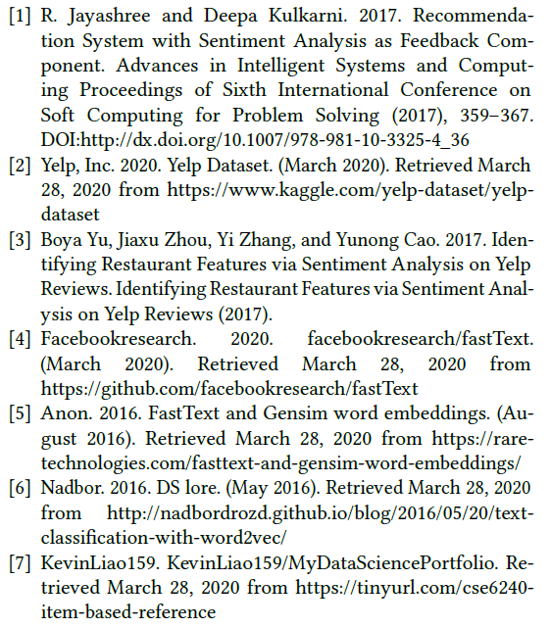
References:

Slide 21
Delete: Notes to self.
Need to create a slide and put it at the beginning of the presentation as a use case to show:
Types of predictions:
Combined system: User A ( no needed rated restaurant G), Given favorite restaurant Z what is next great restaurant X to go to ?( combined system) with right side and left side.
Left side of the diagram: User A ( rated restaurants several restaurants), what is the rating of any restaurant that the user has not been to.
What is really needed ? (did the user really need to rate anything ?)
User A provided what his/her favorite restaurant is.
Does the favorite restaurant Z need any ratings ?
Does the recommended restaurant X need any ratings ?

